Slide 1
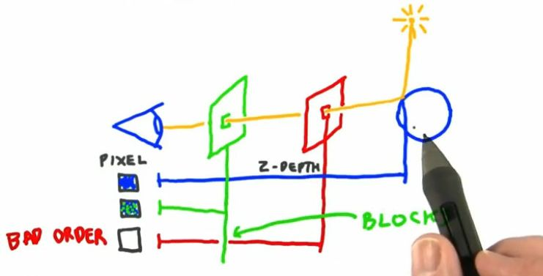
Computer Graphics in a MOOC
Beyond the Hype and Hysteria
Eric Haines
Autodesk, Inc.

Slide 2
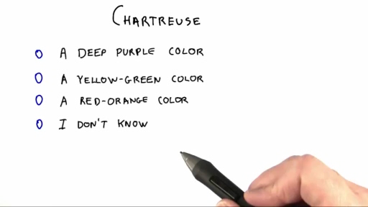
Chartreuse?

Slide 3
Outline
What’s a MOOC?
Making a computer graphics MOOC
Lessons, quizzes, exercises, forum, wiki
Technologies: WebGL, three.js
Why make a MOOC?
What went right and wrong
MOOCs: savior of mankind or sign of the apocalypse?
Notes:
First of all, here’s the bad news of a lecture such as this: you can’t click a link and skip to the part of the talk you’d like to hear.
Show of hands: how many people have tried a MOOC? How many have tried more than one MOOC? How many have finished a MOOC?

Slide 4
MOOC: Massive Open Online Course
Show of hands, please
Massive: course is worldwide
Open: course is free to take, to download, etc.
Online: on the web
Course: what’s a “course”?

Slide 5



The Big Three MOOC Producers
- MIT, Harvard, Berkeley, U. of Texas
- 534 courses from 107 partners
- - out of Stanford, 28 courses

Slide 6

The Bigger One
Over 5 years old (vs. 2011 or 2012).
6 million unique visitors a month.

Slide 7
Massive
The modest course I taught, “Interactive 3D Graphics”, has over 32,000 signups to date.
That’s the bragging number. Completion rates are quite small.
400 students are active on an average day.
1500 are active at least once during the week.
Notes:
Since there’s no real loss if you don’t complete, and no academic credit at the end, two motivators are gone: loss of investment and ability to gain success.

Slide 8
Massive
This graphics course is worldwide:
~128 countries
total
Notes:
Some students literally cannot get this class within their country.
Also, being a full-time (or even part-time) student is a commitment: time, location, money.

Slide 9
Open
Which sort of “open”?
For Udacity:
Open registration
Free of charge
Materials free to download – avoids censorship of YouTube in various countries
Udacity retains copyright:
Other institutions cannot use w/o permission

Slide 10
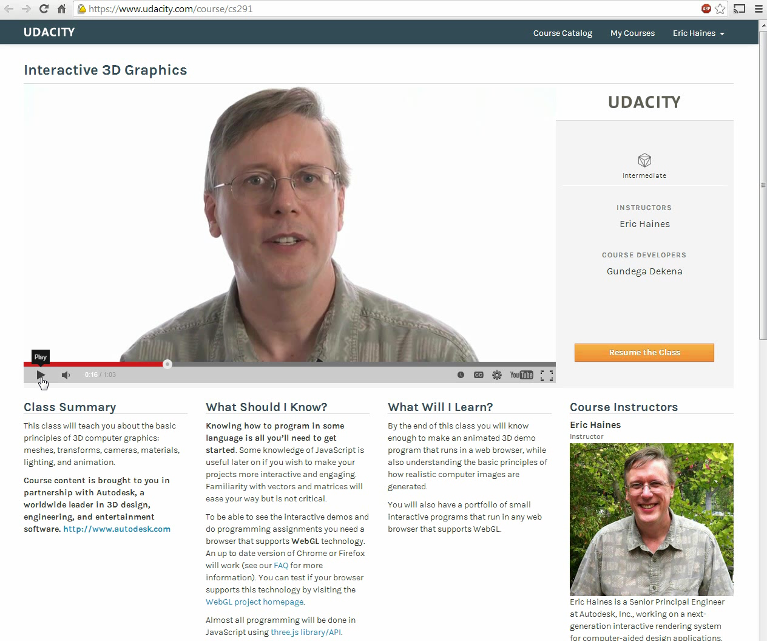
Online
Notes:
Sound is off

Slide 11
A Course, of Course
But what’s a course?
Minimums, to my mind:
Organized syllabus
Lectures, quizzes, exercises
Communication with instructors and/or peers
Optional:
For course credit (where the $$$ are made)
Pace: self-paced vs. start & end dates
Notes:
Self-paced has the advantage of start and continue at any time, and skipping stuff you don’t care about. Start & end dates favors forming a community.

Slide 12
Concerns about MOOCs on Campus
Amherst: decided to not offer MOOCs
Harvard: 58 faculty demand greater oversight
General professor concerns include:
Don’t want to teach what they didn’t create
Don’t want to compete against ‘superstars’
Don’t feel comfortable on camera
Provosts worry about their business model
Notes:
http://www.economist.com/news/united-states/21587820-many-professors-are-hostile-online-education-learned-luddites
We’ll get back to these concerns at the end of this talk

Slide 13
Why Make a MOOC?
Autodesk’s reasons:
Goodwill: our CEO Carl Bass is a computer graphics guy and likes education.
He’s also on Udacity’s advisory board.
Mindshare: we compete with game developers for talented programmers.
Test the waters: Google and NVIDIA were also creating classes.
Internal training: at least, I’ve used it for such.
Notes:
All Autodesk software is free to students and faculty, out of work professionals, veterans.

Slide 14
Why is a typical class 50 minutes?
Various classes can be fit together more easily by having designated slots.
Traditionally, a bell rang on the hour, marking when classes ended.
50 minutes has been found to be the sweet spot for keeping students' attention.
The length is necessary for a reasonable payback for travel.
Notes:
I can’t say I know the answer.
For answer one: reasonable administrative device.
Answer two is from Patrick Cozzi, and I suspect this might be why courses were originally this length. A pocketwatch was expensive, so the campus bell tower would signal the change.
Answer three: not the case. 10-16 minutes is about the limit of how long you can solidly pay attention. Sorry, no reference.
Answer four: I think this is why the time is spent today. I live north of Boston, near MIT. At MIT the professors put their lectures online.
What this means is that the student often don’t come to class for lectures. The student doesn’t have to get up for those 8 am lectures, doesn’t waste time going to and from class. One professor I talked with said he’s almost prefer just putting them online at his leisure and not having a half-empty classroom. Other advantages: the student can pause and rewind.

Slide 15
MOOC Lessons, Quizzes, Exercises
Lessons are usually 2-3 minutes each.
“But how can you teach anything that quickly?”
Quizzes and exercises should come every 10 minutes or less, to keep the student engaged.
Student can easily see progress and continue.
Student can zip through or just do a lecture or two at lunchtime.

Slide 16
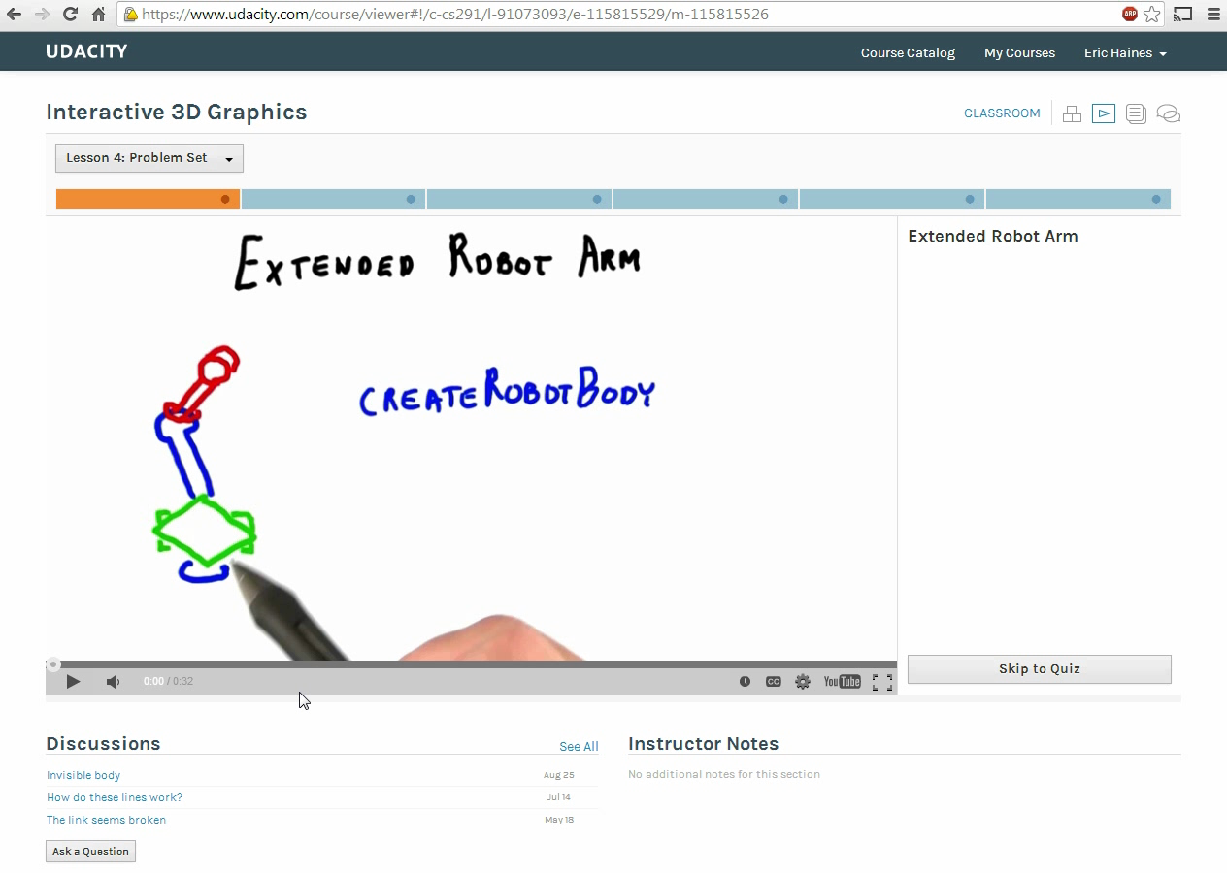
MOOC Classroom Example
Notes:
Note at start I hover over other lessons. This set of videos is the problem set for Lesson 4, on Transforms.
Notice how code editor shows JSHint errors as you type.
Diff image helps student notice the problems with what he’s doing.
Don’t put important info in the answers, as people don’t watch!

Slide 17
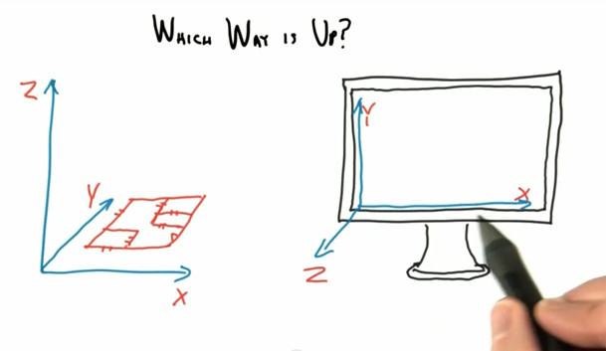
Draw and Talk
Friendlier, engaging, less distracting
Notes:
Ask people which way is up.
I liked computer science as a field because I would no longer need to draw, longhand write, or talk at length. For the MOOC I did all three. Voice actors have a union limit of 2 hours of talking a day. I’m not in a union.
I have a newfound respect for weathermen. Salman Khan of the Khan Academy is a national treasure, since he can write and lecture at the same time.
Writing on the screen is like I’m sitting next to you.
Having a teacher look me in the eye from a video screen is really pretty bogus. Also, I hate doing headshots.
Head in the lower left corner of the screen is distracting to me. I know a person is talking, I don’t have to see his head.

Slide 18
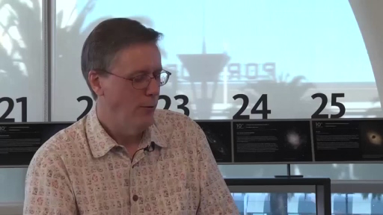
Other Video Options

Slide 19
Translation Problem
English is written in the slides themselves.
There are a few mechanisms to help students:
Captions generated on YouTube itself
Downloadable captions in English
Slow down (or increase) delivery speed.
This works better with the video player VLC offline: 2/3rds mode.
Pause and replay!

Slide 20
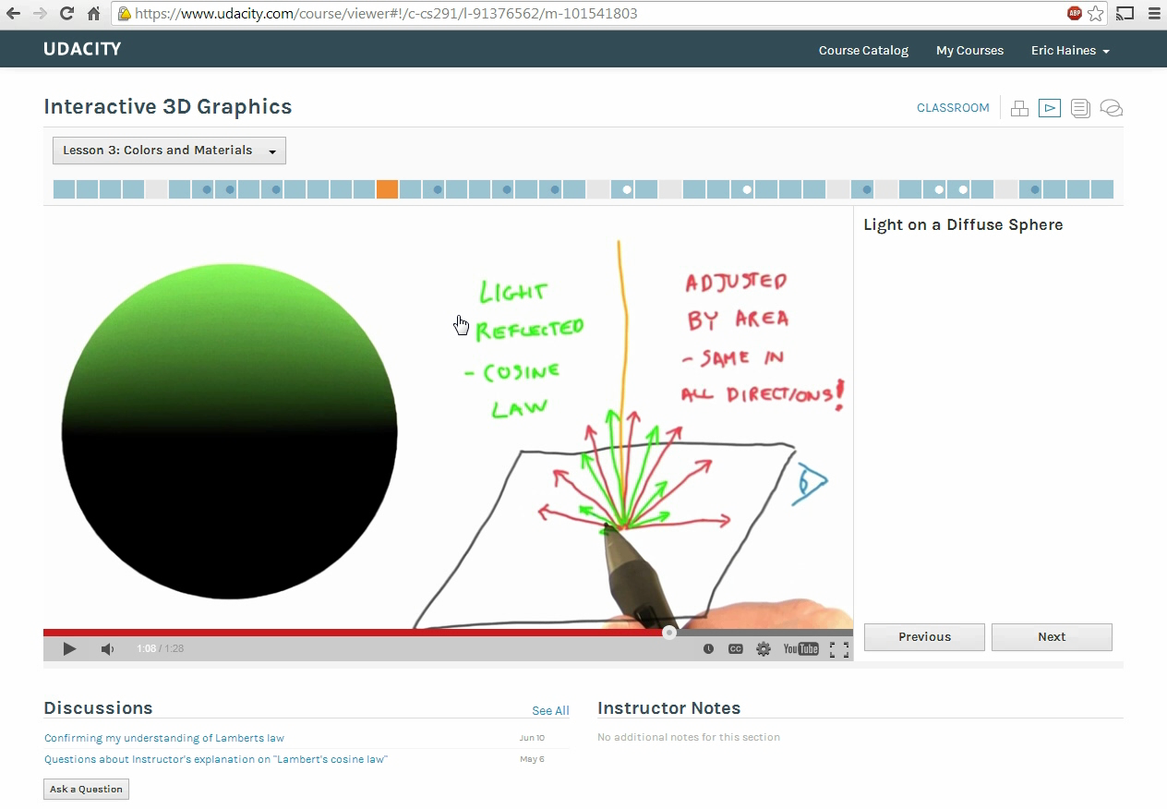
Translation and Speed Example
Notes:
The editors tended to edit such that I was breathless, never inhaling.

Slide 21
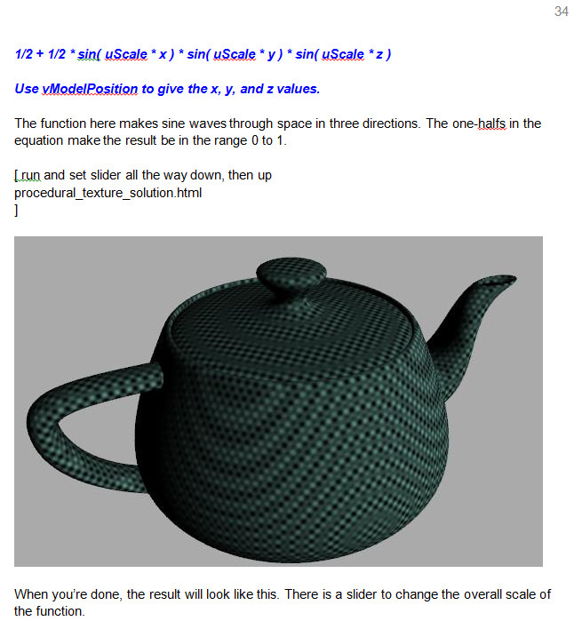
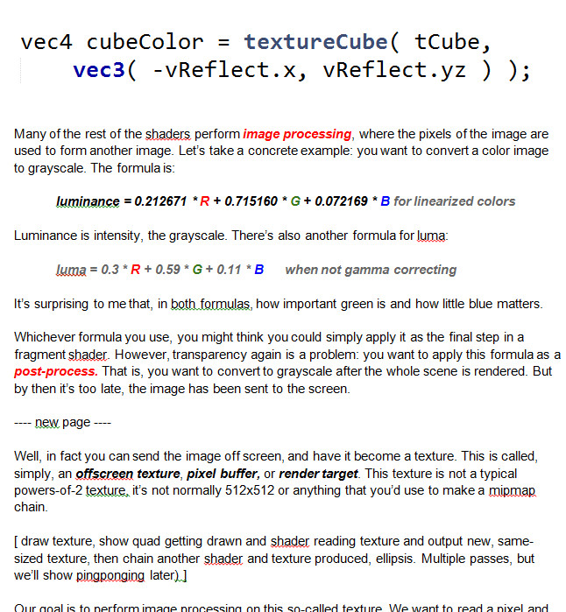
Supplemental Materials
The scripts for all lessons are downloadable.

Slide 22
Why Scripts?
Just about everything said should be written down beforehand.
Otherwise, you will ramble
Non-teachers have an advantage: no “bad habits”
50 minutes of normal class time → 11 minutes of material?
I suspect it’s more like 50 → 17 minutes
10 week class → 800+ page illustrated script
Notes:
Non-professors have an advantage

Slide 23
Scripts Can Be Proof-Read
My special thanks to:
Patrick Cozzi
Mauricio Vives
Branislav Ulicny (AlteredQualia)
Gundega Dekena

Slide 24
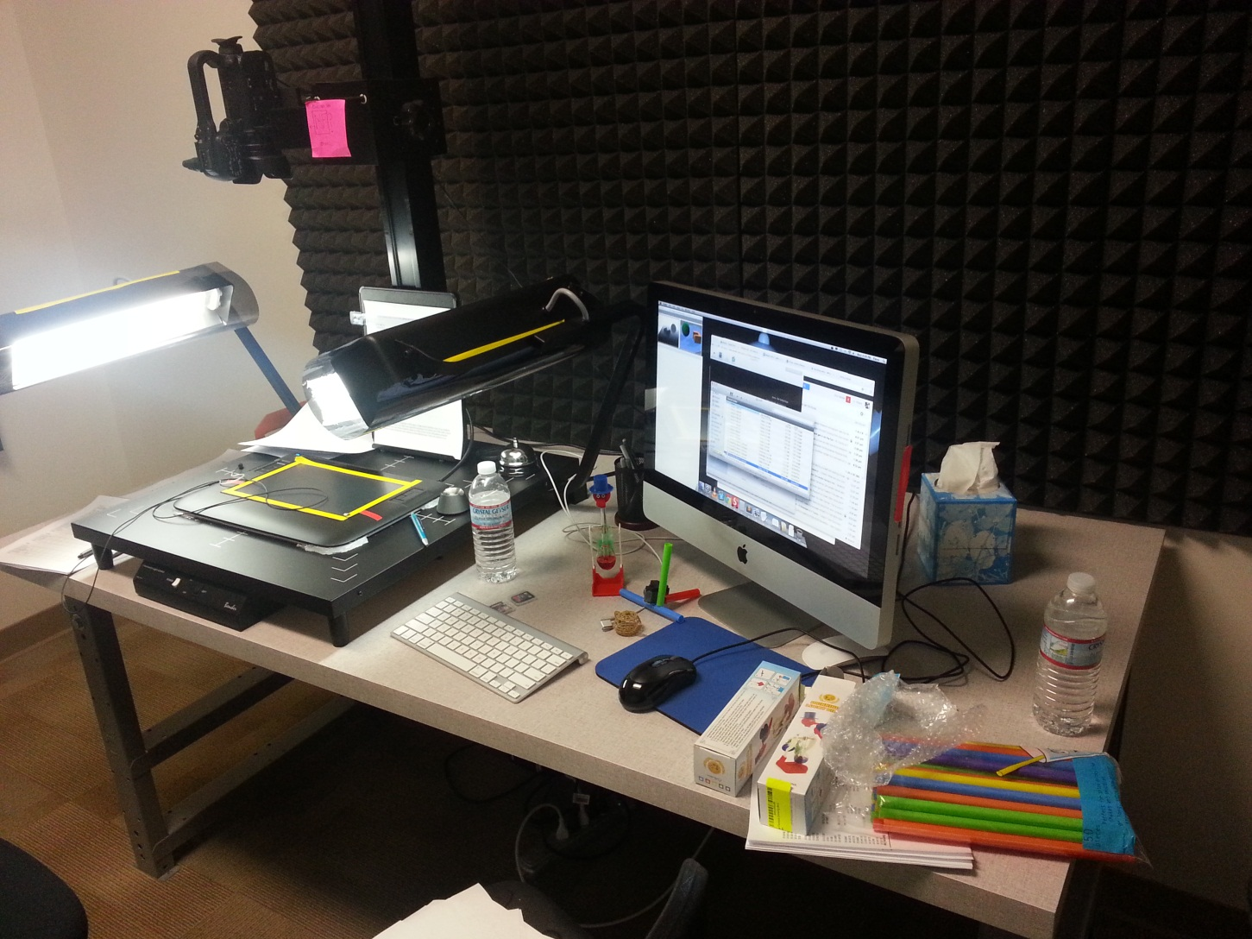
As a teacher, your classroom:
Notes:
Hard to keep energy up talking to a tablet. You repeat certain sentences 10 times, and it’s hard to gesture and read from a script at the same time.
Set it up, record for 2 hours, then find you forgot to turn on the screen capture software or overhead camera.

Slide 25
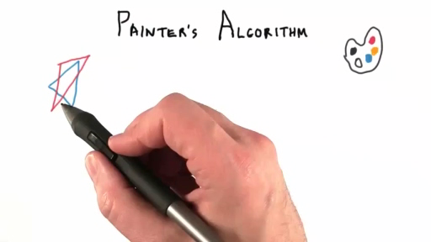
Typical Lesson: Painter’s Algorithm
Notes:
A typical lesson

Slide 26
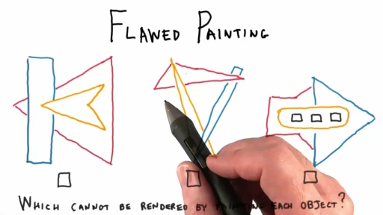
Quiz Question

Slide 27
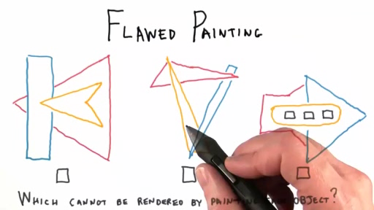
Answer

Slide 28

More Beauty = More Educational?
Notes:
http://acko.net/files/fullfrontal/fullfrontal/webglmath/online.html – this stuff is great, and gets better as you go along
MathBox
Yes, this is all happening in your browser.

Slide 29
Online Support
Course Developer Gundega Dekena helps.
Forum:
Questions appear on relevant lesson’s page.
Students can help each other.
Me, I check it about daily. Forever.
Wiki:
Instructor-only access.
Syllabus, tips & tricks, downloads, etc.
Notes:
The detailed syllabus was originally created by a student, with my guidance. Since its creation, I’ve been filling in what each lesson is about.

Slide 30
Underlying Graphics Technologies
Every computer (even grandma’s) has a GPU.
WebGL – to send graphics to the GPU.
But, WebGL itself is not beginner-friendly, so:
Three.js – scene graph library that calls WebGL
JavaScript – to call three.js in browser.

Slide 31
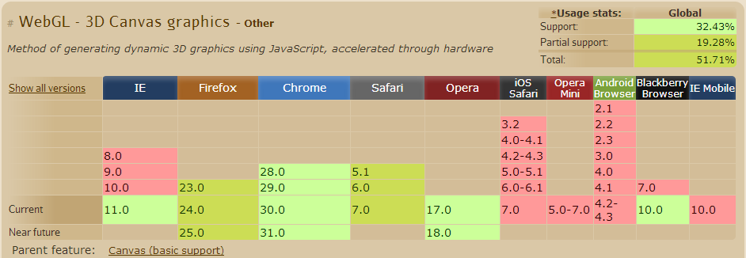
WebGL
March 2011 marked Release 1.0
Pretty good penetration; Chrome’s best
Internet Explorer finally added it
Notes:
WebGL is essentially a somewhat older version of OpenGL for the web.
Table from http://caniuse.com/#feat=webgl

Slide 32
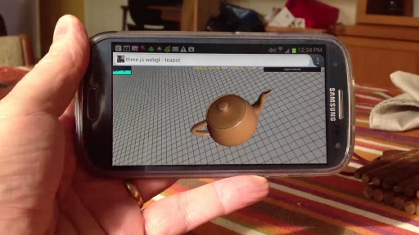
Mobile Support
WebGL works on Firefox and Chrome for some Android phones.
Apple allows WebGL on mobile only for advertisers (concerns about malicious/poor code)
Can’t really do exercises on the phone.

Slide 33
Three.js
WebGL has you writing GPU vertex and fragment shaders, has minimal matrix support, and no higher level libraries.
Laborious for students to get a square on screen
Three.js is a scene graph: set up objects, lights, camera and interact with scene.
Hides shaders, unless you want to use them.
Lots of example code.
Notes:
Course is about computer graphics theory, not about how to use a particular API.

Slide 34
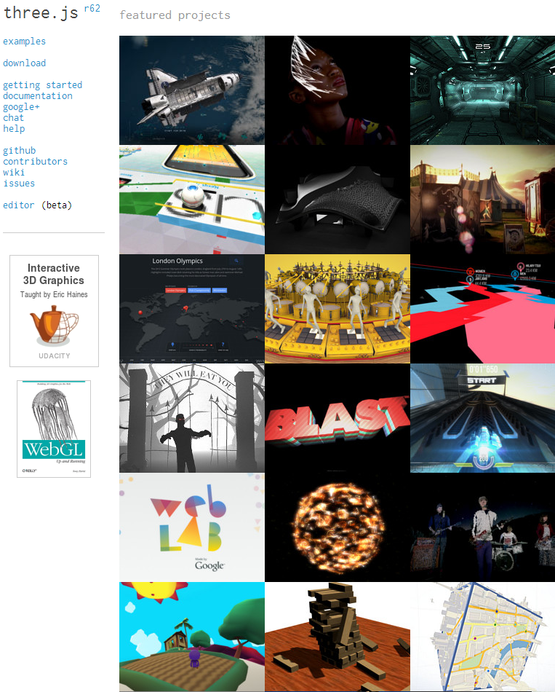
Three.js Support
Tons of libraries:
Shadows
Keyframing
Picking/Collisions
Post-processing…
Free, on Github
Active community
Hackery; weak docs
Notes:
threejs.org – worth your while visiting

Slide 35
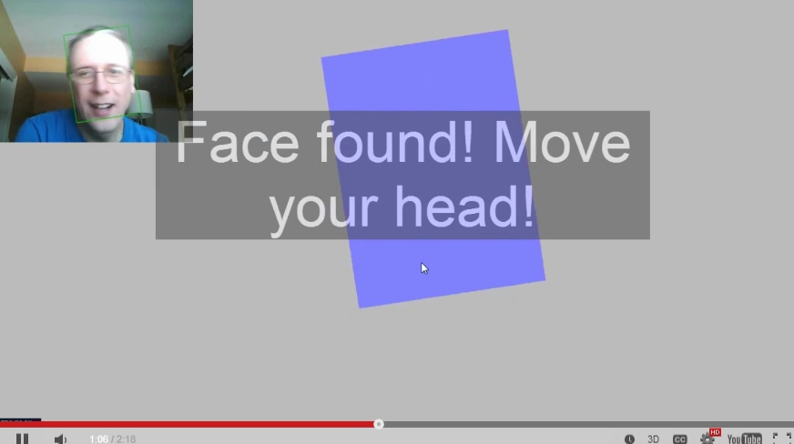
Three.js + head-tracking example
Notes:
No sound.

Slide 36
JavaScript
Not much like Java, despite the name.
“JavaScript is a sloppy language, but inside it there is an elegant, better language.”
Well-supported for web browsers.
Debugger is built-in for Chrome; hit F12.
However, this doesn’t quite work well in-browser.
Best of all, every bit of code is readable
Well, barring obfuscation
Notes:
Definitely get “JavaScript: The Good Parts” – read the appendices first.

Slide 37
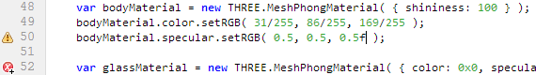
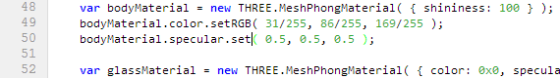
JavaScript
Very easy to go wrong with JavaScript.
Our partial solution: JSHint built into browser.
Easy to go very wrong, nonetheless
Notes:
Definitely get “JavaScript: The Good Parts” – read the appendices first.
Thank you Mr. Cozzi

Slide 38
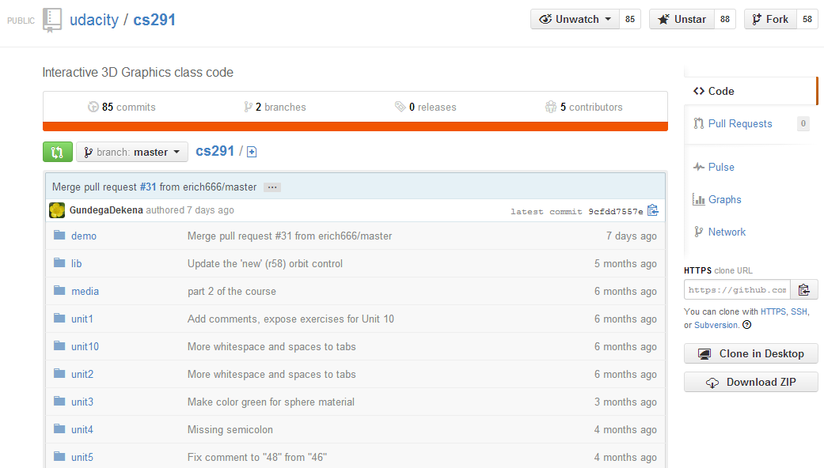
Code on Github
Allows students to improve the code.

Slide 39
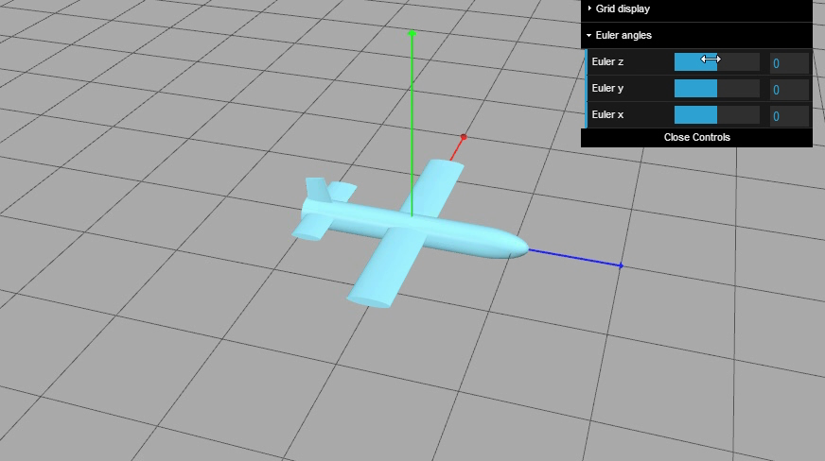
Euler Angle Demo
Notes:
João Sousa (from Portugal) improved this demo

Slide 40
Grading
We used a simple image compare system:
Check pixel’s maximum difference in R,G,B
If greater than X levels, pixel fails
Count how many pixels failed
If greater than Y levels, code does not pass
Sometimes no change in code would pass; sometimes nothing would pass. Tweak!

Slide 41
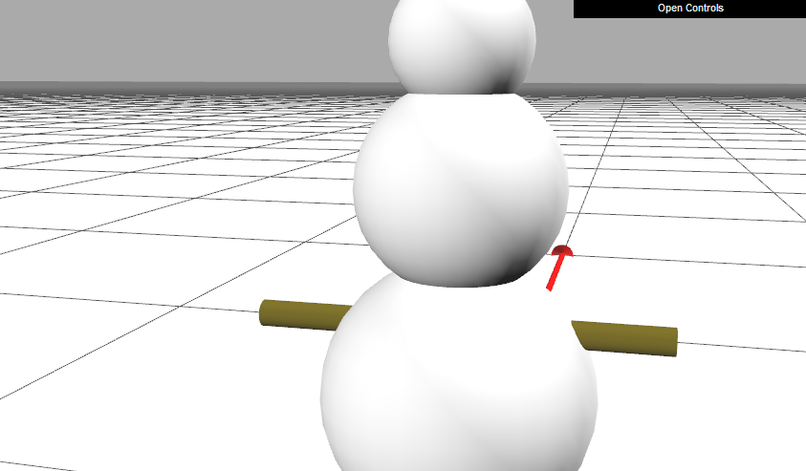
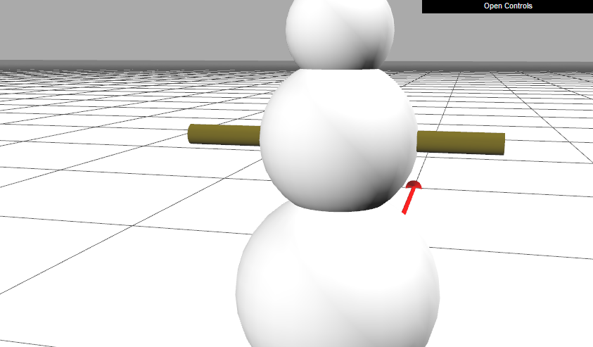
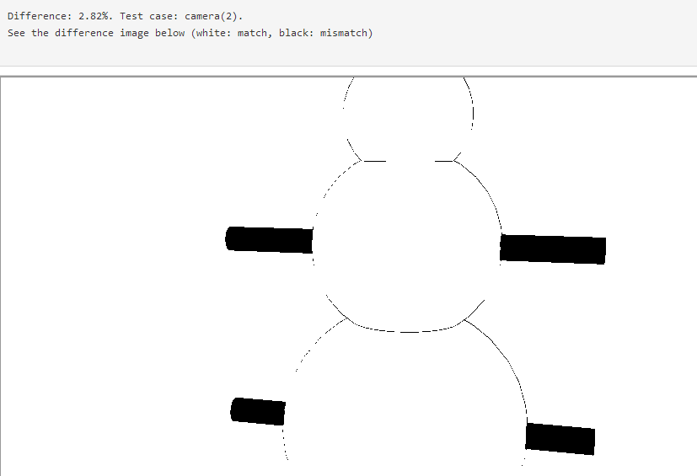
Image Compare Example

Slide 42
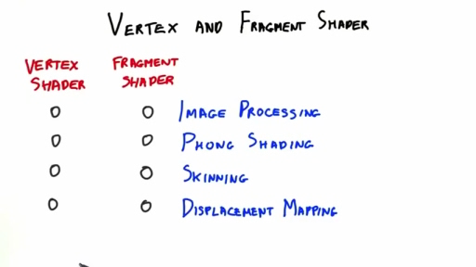
Final Exam Example
Notes:
No answer is wrong, but the software will allow only one response to be right. Problem is that the software is limited in what it can recognize. We avoid short-answer tests. Also,

Slide 43
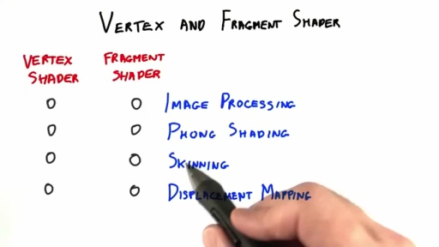
Answer

Slide 44
Problems
Ran out of time at end of making course
Course needed to be debugged after release
Completion rate low
No money invested, no real credits given
Little to no tracking & helping students
Minimal student-helping-student
Self-paced == lack of much community
Videos are mostly hard to change

Slide 45
Successes
It works! We didn’t know it would.
WebGL/three.js means a demo is a click away
Kudos for our time spent on the forum
For me, currently 15 minutes a day
Reached (and still reaching) a lot of people
Organized curriculum beats “search on the web”
Self-paced = learn what you want, when you want
It’s massively fulfilling for me
Notes:
Completion rate is not indicative of value.
I’m marking up the syllabus for “if you want to know just three.js, take these lessons”.

Slide 46
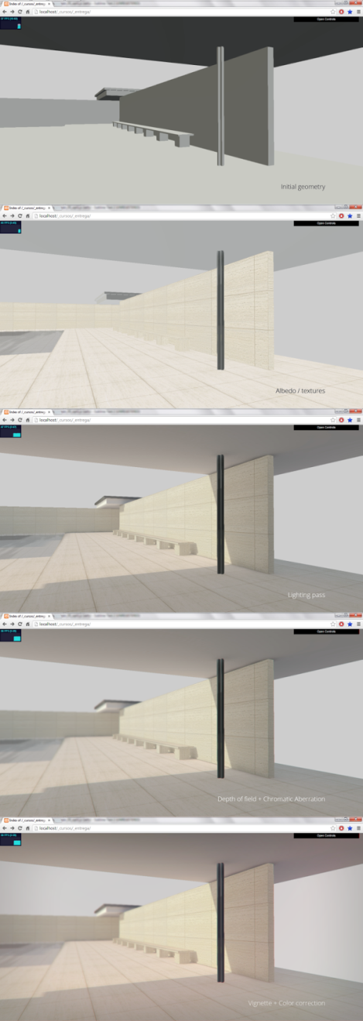

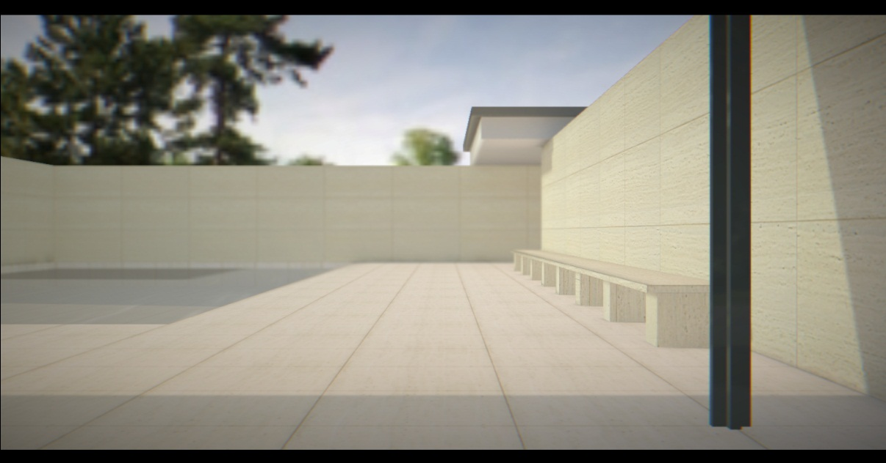
Antonio Suazo
Architect in Chile
Won People’s Choice contest
Making his hobby studio go pro
Notes:
http://blog.udacity.com/2013/09/architect-advances-career-after-3d.html

Slide 47
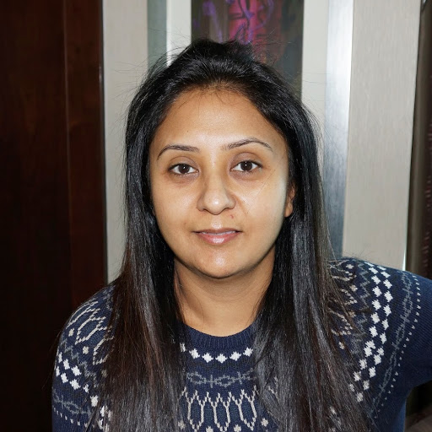
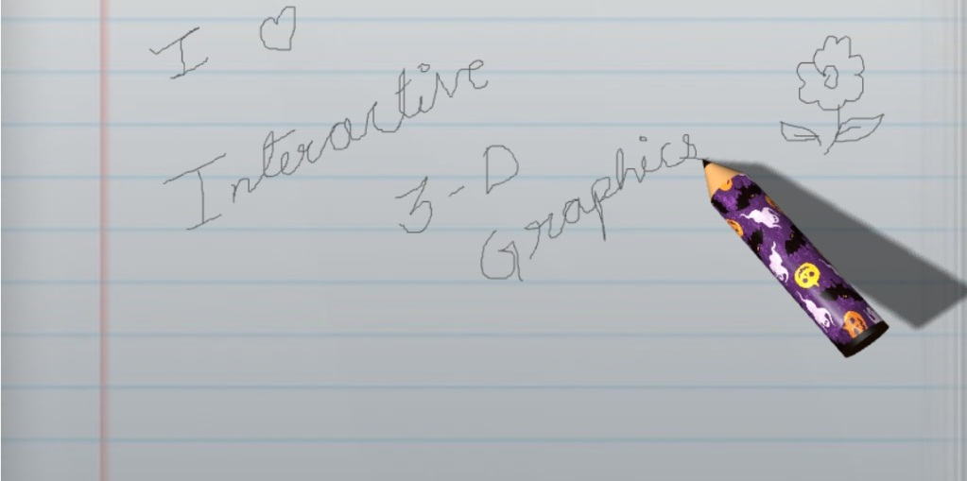
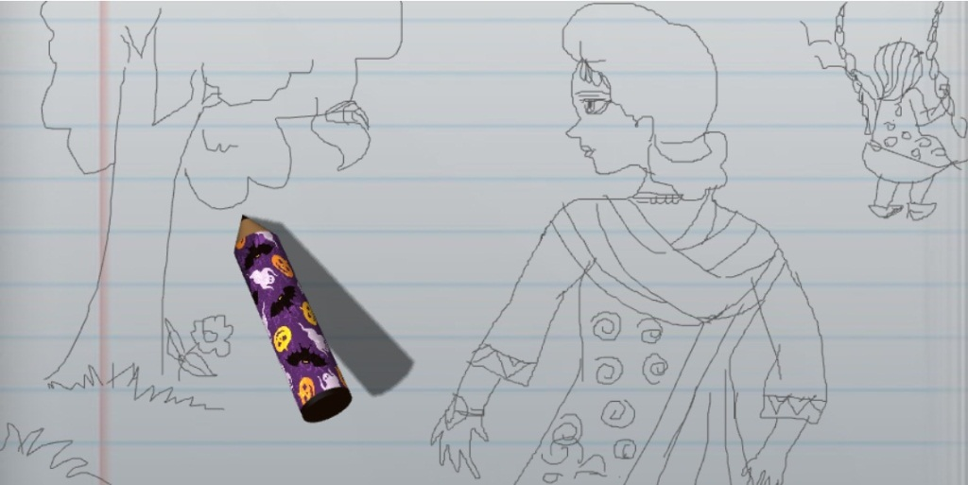
Anubha Banerjee
Studied line smoothing

Slide 48
Enjoying your Career
The certified Eric Haines® method:
Get involved in SIGGRAPH
Create open source before it became a thing (Standard Procedural Databases)
Blog before it became a thing (Ray Tracing News)
Meet like-minded souls and put more on web
Help write a book – and learn the subject
Notes:
Really, though, all these things I did because I enjoyed them, not as career-advancers.

Slide 49
Your Own Method – Some Ideas
Offer a great resource, or host one:
Ke-Sen Huang’s conference site
Our own collision detection grid page
Advances in Real-Time Rendering hosting
Publish:
Journal of Computer Graphics Techniques
The Graphics Codex by Morgan McGuire
Make a cool demo, mod, or library
Three.js
Shadertoy!
Notes:
I feel graphics has entered the engineering phase.
A website can be hosted for $75 a year. Bluehost!

Slide 50
MOOCs: Better or Worse?
What’s the difference between a giant lecture hall vs. a video of the lecture?
Student dedicates time when going to a lecture hall. Even when sleepy.
Student can pause to check cellphone when watching the video version.
Analogy: watching a live play vs. watching a movie on DVD. Both have advantages.

Slide 51
Limitations due to Massiveness
Can’t easily keep track of students’ progress
Nor can many universities
Tracking tools being developed
Automatic grading limits creative projects
Somewhat ameliorated by contests
Self-paced does not foster community (but semester launches are too infrequent).
How about monthly or bi-weekly launches?
Notes:
Launches could also be “hard core, do it in 3 weeks” vs. “I’ll probably take half a year”.

Slide 52
MOOCs: Good or Evil?
Can help rethink the process:
Flipped classroom
Drilling until subject is mastered (“10 right” rule); truly no student left behind
Can be misused, “let’s get rid of faculty.”
Imagine if every teacher had to write their own textbook for a course…
- MOOCs are just another tool.
Notes:
Salman Khan’s initial rule was “student should get 10 math problems right in a row, in a unit, to prove competency”.

Slide 53
Final Thoughts
Is education (and course credit) based on seat time or competency?
Need more than one MOOC on a subject.
MOOCs can supplement and complement.
A campus signals “my job now is to learn”.
Parties and sports and all the rest are a lot better face to face than broadcasted.
Alumni donate.

Slide 54
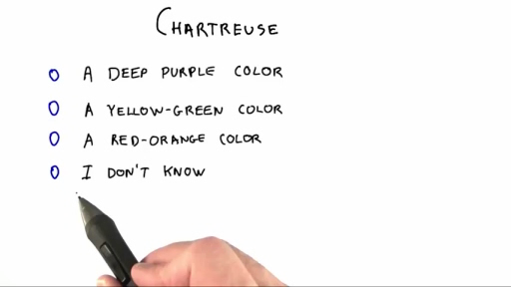
Answer

Slide 55
I’m at
erich@acm.org
http://erichaines.com

